Slide 1
Pill camera

Slide 2
Contents…
1. Introduction to capsule camera
2.Description
3.Components
4.Procedure
5.Application
6.Advantage
7.Drawbacks
8.conclusion

Slide 3
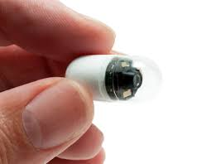
Introduction of capsule camera
Imagine a vitamin pill-sized camera that could travel through your body taking pictures helping diagnose a problem which doctor previously would have found only through surgery.
Doctor able to see the inside lining of digestive tract. The examination is performed using an endoscope-a flexible fiber optic tube with a tiny TV camera at the end. The camera is connected to either an eyepiece for direct viewing or video screen that displays the image on a colour tv.This procedure used for gastro intestinal(GI) disease and treatment as well ….

Slide 4
Descripition
The device called the diagnostic imaging system comes in capsule form and contain a camera, lights, transmitter and battery.
The latest pill camera is sized 26’11mm and is capable of transmitting 50,000 colour images during its traversal through the digestive system of patient.

Slide 5
Components…
Optical dome – this shape results in easy orientation of the capsule axis along the central axis of small intestine and also propel the capsule forward easily. The optical dome contains the light receiving window
Lens holder - the lens holder is the part of the capsule which accommodates the lens. The lens is tightly fixed to the holder so that’s it doesn’t get dislocated anytime.

Slide 6
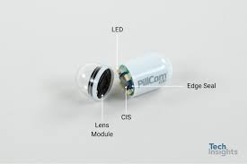
Lens – 1. The lens is an integral component of the capsule.
2. It is arranged behind the light receiving window.
illuminating LED’s – Around the lens and CMOS image sensor,four LED’s(light emitting diodes) and present. These plural lighting devices are arranged in donut shape.

Slide 7
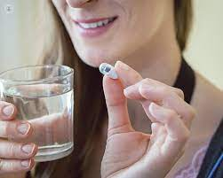
Procedure of capsule camera
Capsule is swallowed by the patient like a conventional pill.
It takes image as it is propelled forward by peristalsis.
A wireless recorder,worm on a belt,receive the images transmitted by the pill.
A computer workstation processes the data and procedure a continuous still images.

Slide 8
Application…
Crohn’s disease
Mal-absorption disorders
Tumors of the small intestine and vascular disorders
Ulerative colitis
Medication related to small bowel injury.

Slide 9
Advantages…
Painless, no side affects or complications
Small size, so it can move easily through digestive system
Made up of bio-compatible material, so it doesn’t cause any harm to oru body.

Slide 10
Drawbacks
Impossible to control camera behaviour
Vomiting
Fever
Abdominal pain
Chest pain

Slide 11
conclusion
The capsule endoscopy is a pioneering concept of medical technology of 21st century.
This endoscopy system is the first of its kind to be able to provide non-invasive imaging of entire small intestine.

